Slide 1
IMSE/CIS 381 Industrial Robotics
LAB 0
Introduction
Lab Instructor: Gabriele Galli
Email: ggalli@umich.edu

Slide 2
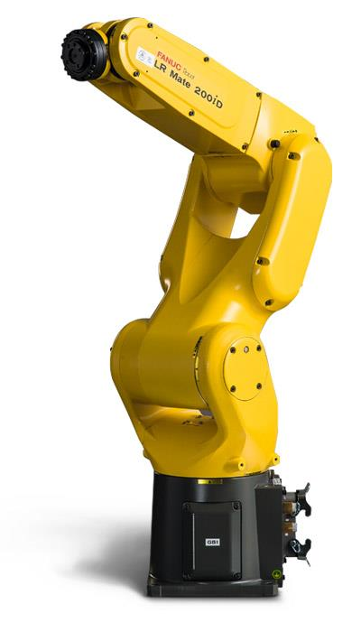
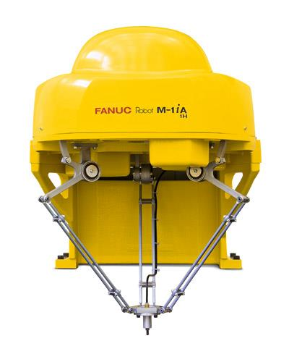
Introduction to the Fanuc Robots
Fanuc robot LR Mate 200iD
(Six Axes Robot)
Fanuc robot M-1iA (Delta Robot)

Slide 3
Introduction to the Fanuc Robots
What are Fanuc Robots?
Where are they used?
How do they run automatically?

Slide 4
SAFETY
Only one person should operate the teach pendant at a given time
All personnel and unnecessary equipment should be outside of the work cell
Please turn off the safety switches after you have made sure that nothing is inside the work cell
If not sure how to proceed safely, please ask the Lab instructor
Better be safe than sorry!

Slide 5
FORMAL TECHNICAL REPORTS
Cover sheet or Title Page
Abstract
Table of Contents
Introduction
Apparatus
Methodology (Experiment procedures)
Discussion
References
Appendices

Slide 6
GENERAL TIPS
Be clear and concise.
Support statements with data from your experiment. Do not state anything that is purely opinion or make any statement without evidence.
Use past tense. The experimental procedure has already been conducted.
Write in third person. Avoid using the words “I” or “we” when referring to the experimental procedure .

Slide 7
GENERAL TIPS
Instead of: | You can use:
“We conducted an experiment showing….”
“I predicted…”
“I jogged the robot on the positive y axis…”
“The experiment
showed…..
“It was predicted…”
“The robot was jogged on the positive y axis…

Slide 8
TITLE PAGE
Title ( clear and descriptive).
Your name.
Lab date.
Lab report due date.
Course Name and Professor name.
Instructor name.

Slide 9
ABSTRACT
People browse abstracts to decide whether they are interested enough to warrant actually reading the paper/visiting the poster/attending the talk.
They are a brief summaries of what has been done and what method was used. Any key results (and their associated errors) should be quoted and main conclusions should be stated.

Slide 10
INTRODUCTION
Talk about the purpose/objective of the experiment.
Give background information on the topic you are doing and why.
Introduce the ideas you will need later in the report without going into detail.

Slide 11
APPARATUS
Equipment
Introduce and describe every piece of equipment used to accomplish this work.

Slide 12
METHODOLOGY
List everything needed to complete your experiment.
Be sufficiently detailed so that anyone could read this section and duplicate your experiment!

Slide 13
DISCUSSION
Include all calculations, graphs, analysis and discussion of your results
Explain the meaning of your results
Explain why your hypothesis is right or wrong based on the data you have taken
Answer the questions given in the lab procedure
Identify possible sources of error

Slide 14
REFERENCES
Make sure all information that was researched is cited within the paper and referenced here.

Slide 15
APPENDICES
Extra material, included for completeness
Do not put your results here i.e. graphs or tables

Slide 16
Any Questions?

